Slide 1

SPROUT UP
Assistive Standing Device
Evan Grealish, Steph Akakabota, Lleyton Elliott,
Darius Nguepi, Michael Rubin, Zhenyu Hu

Slide 2
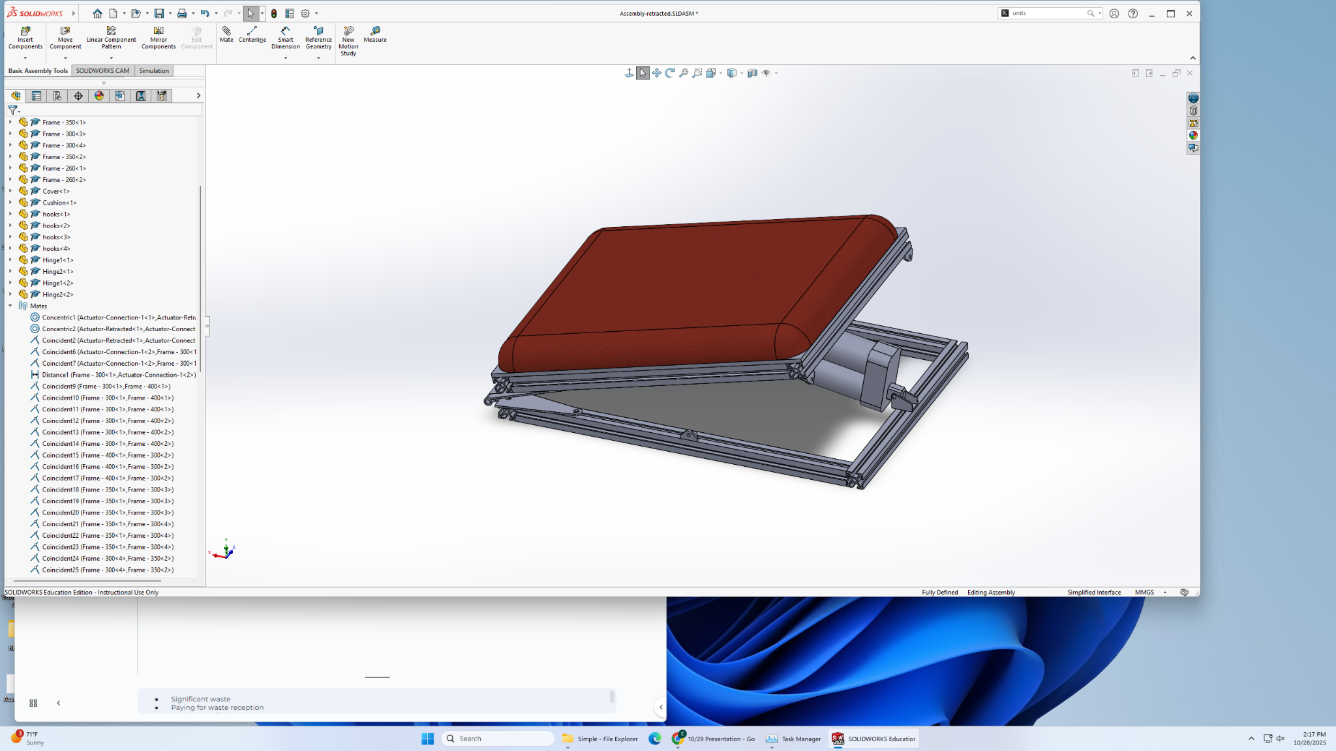
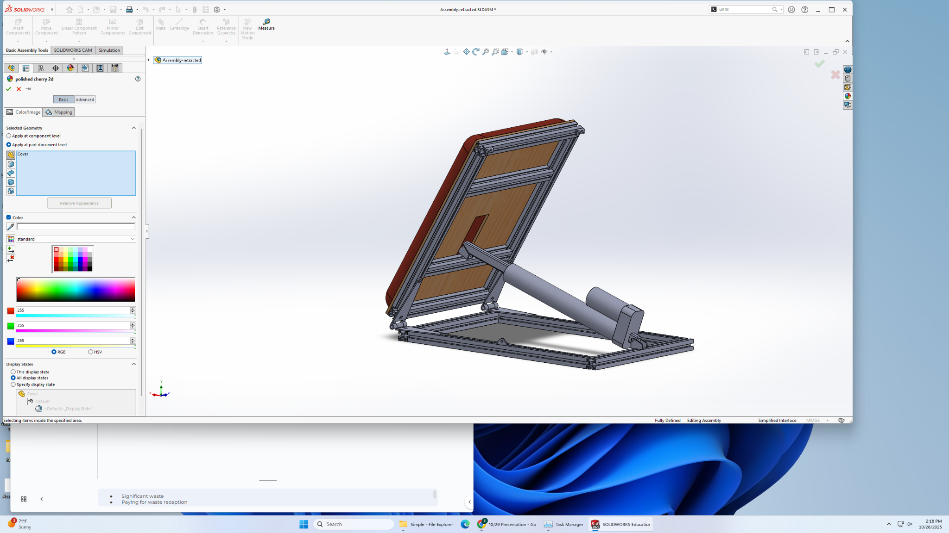
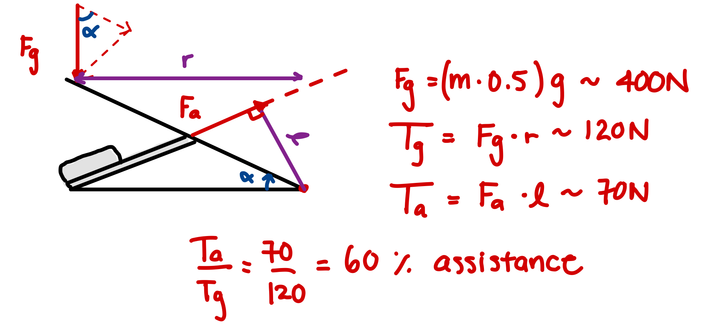
Mechanical Design: Seat & Actuation
SPROUT UP
Priorities:
Weight: 3kg
Power: 60%
Speed: 4 sec
Battery: 2 x (80g, 35A, 1Ah) = 20 cyc
Prototype Cost: <$150
Manufacturability: Off the shelf parts
Next Steps:
FEA analysis
Order and Assemble Prototype
Production Design
Reduce weight & size
Notes:
Significant waste
Paying for waste reception
Food loss realised on P&L

Slide 3
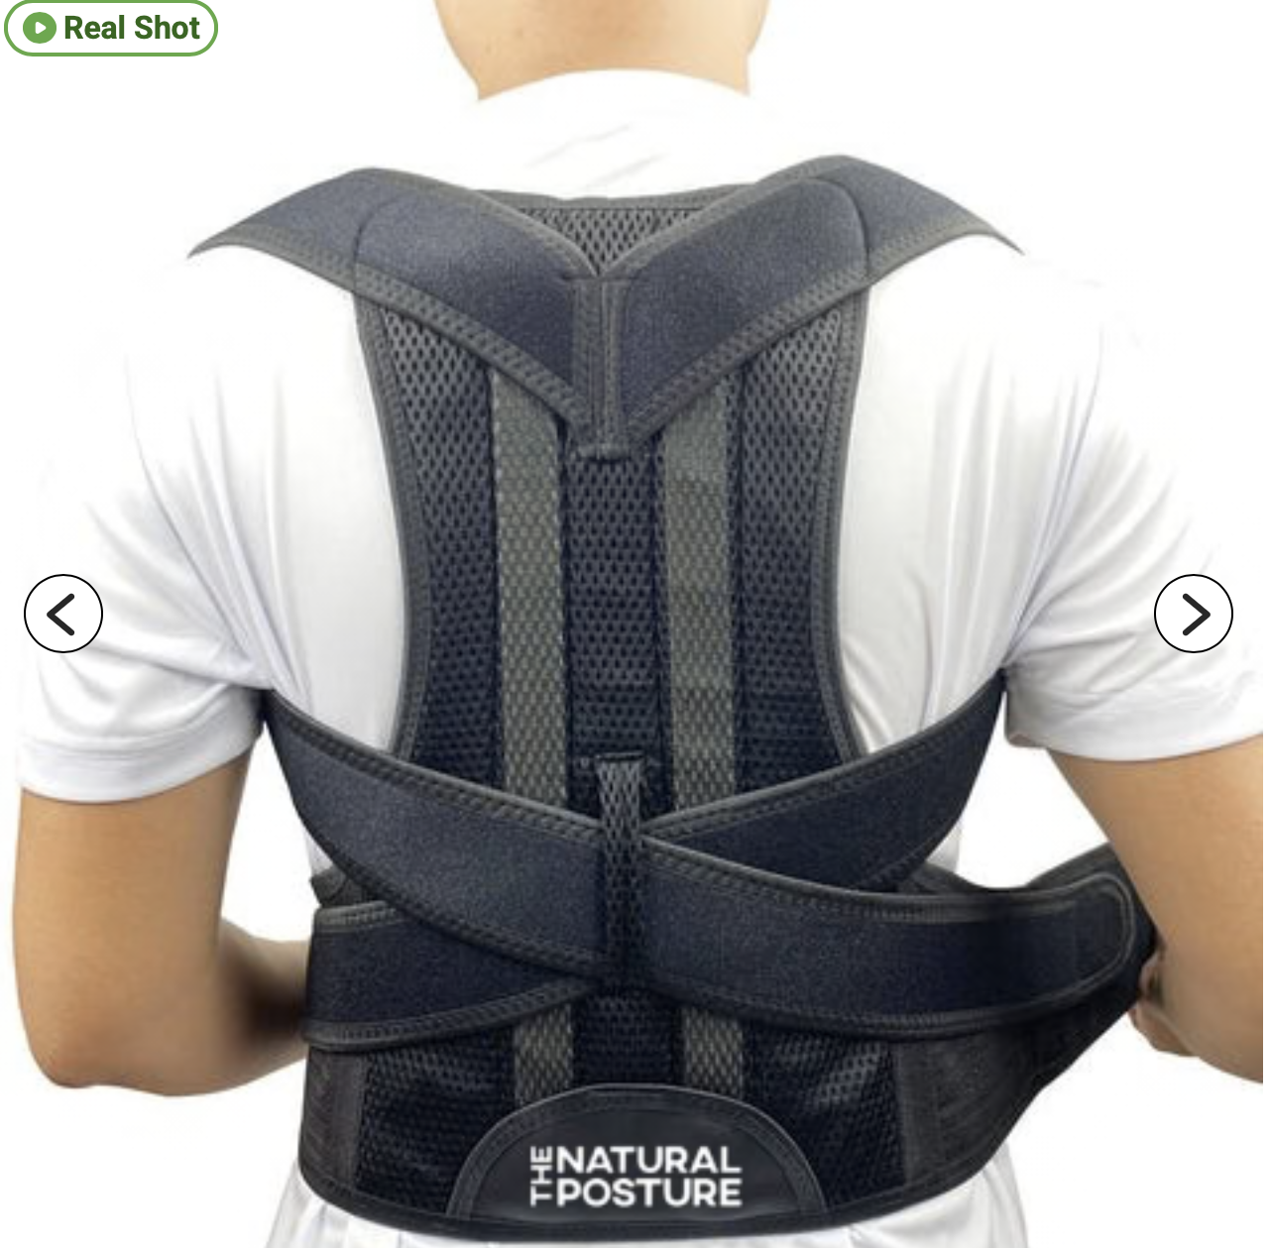
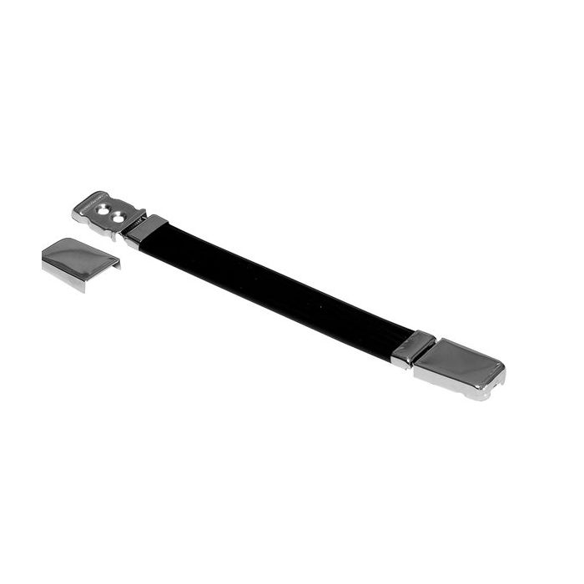
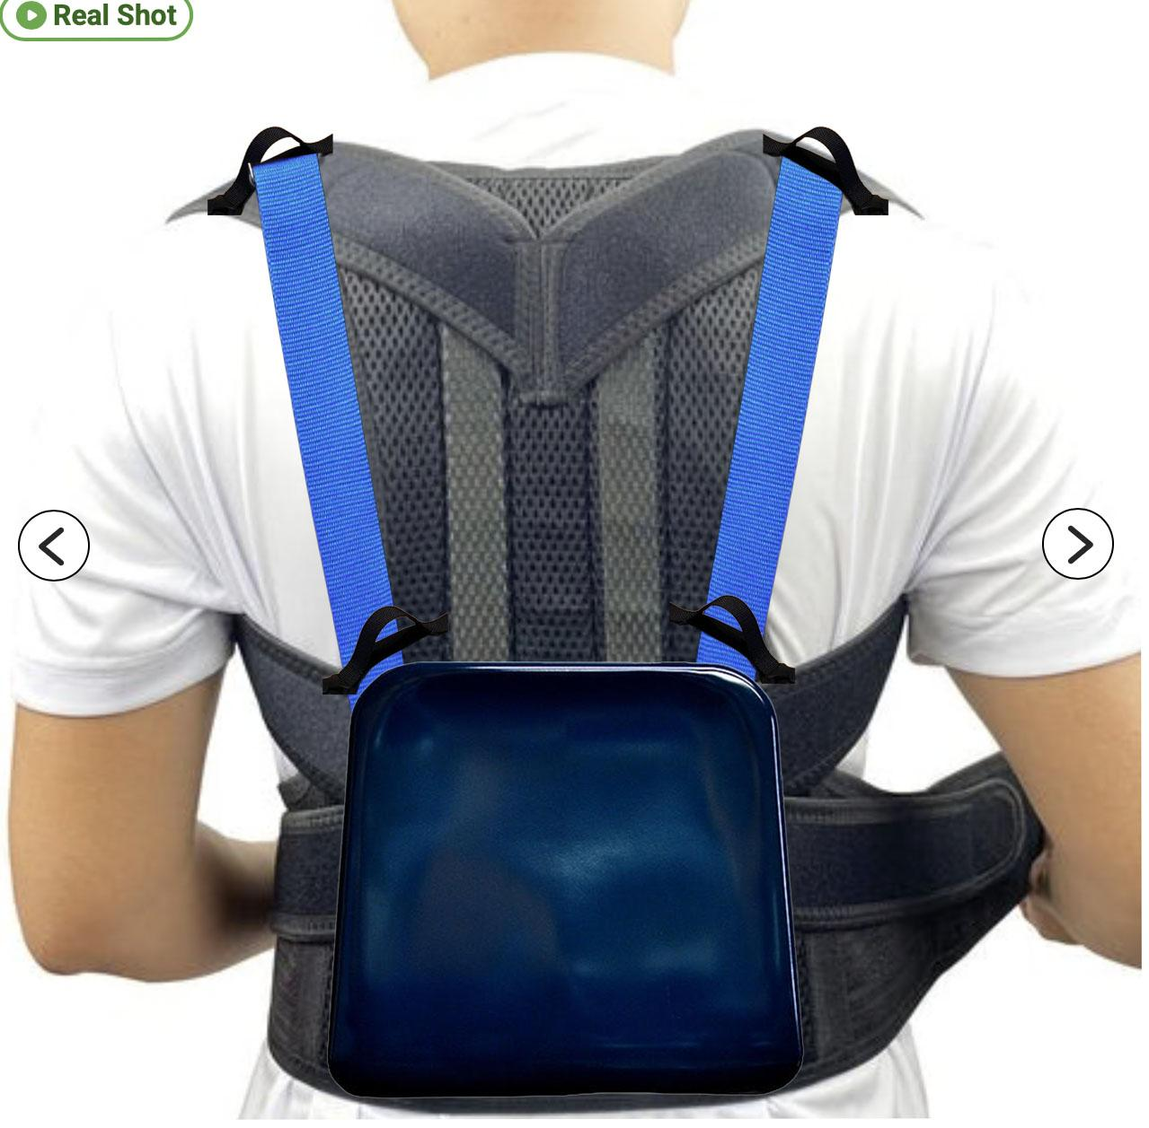
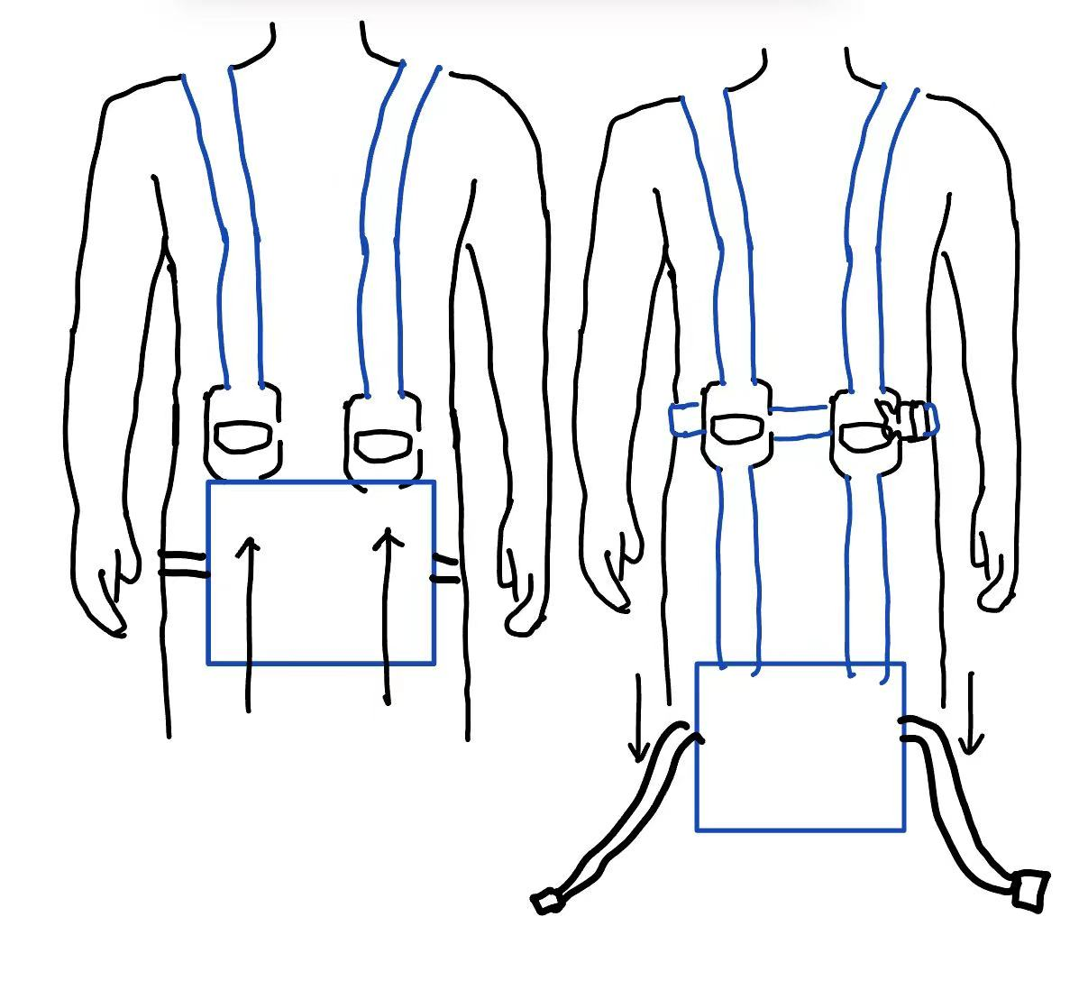
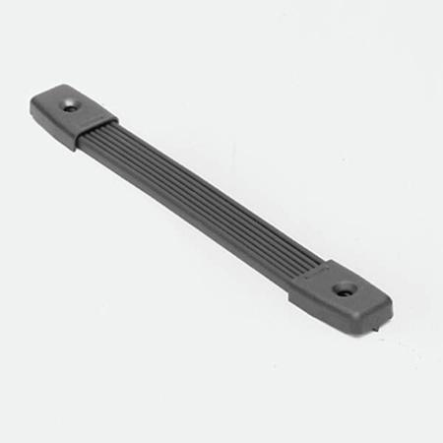
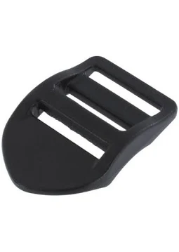
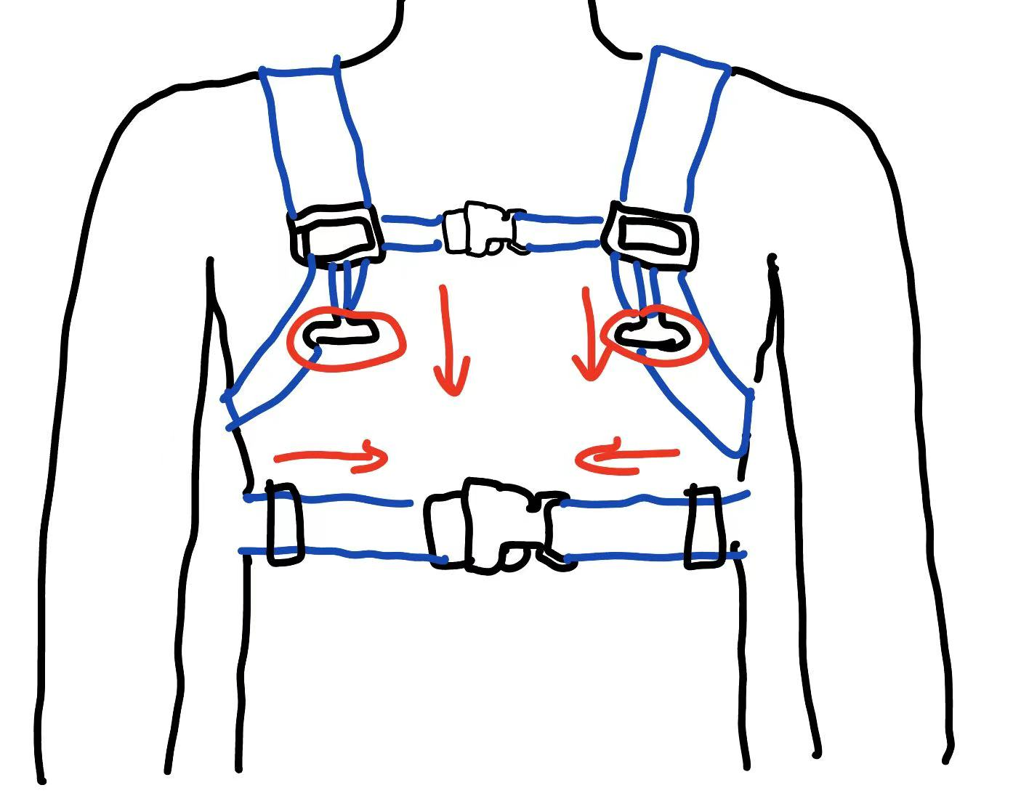
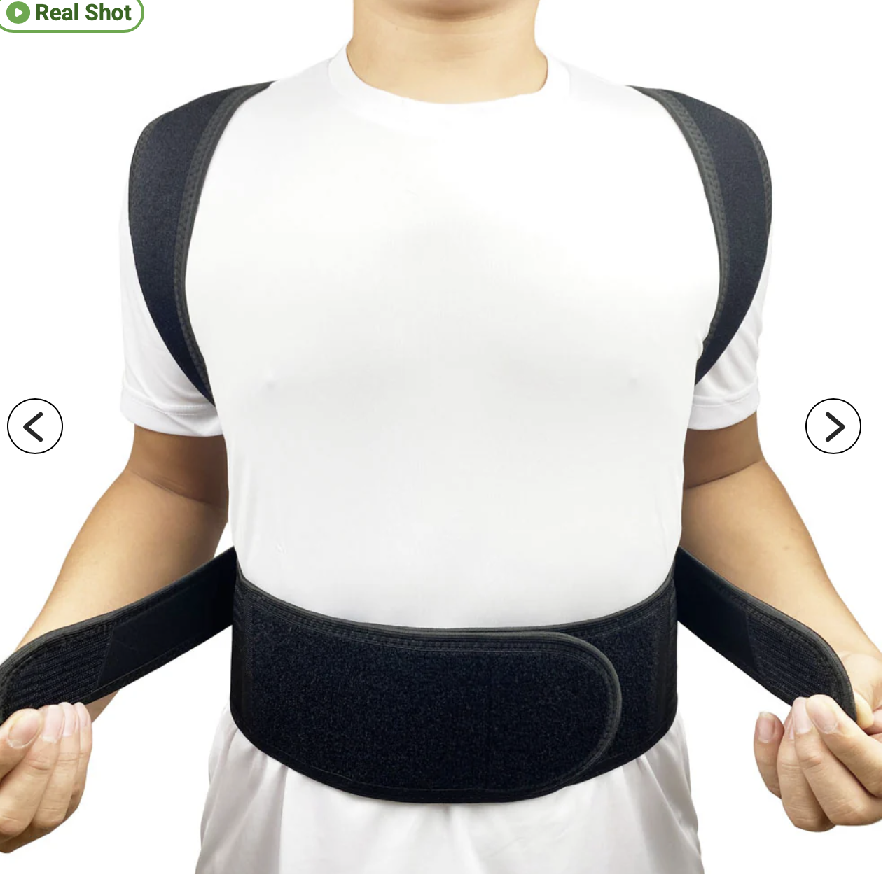
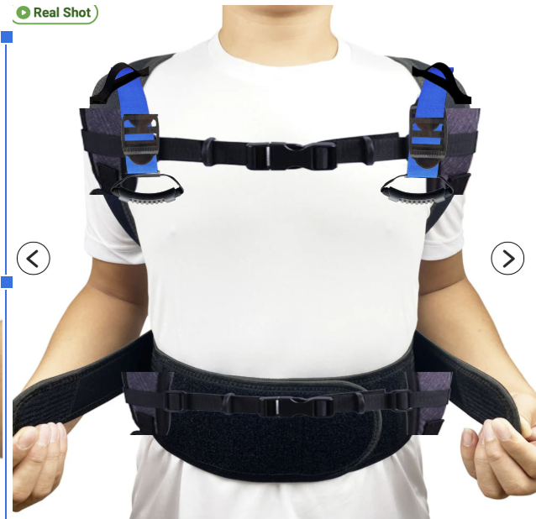
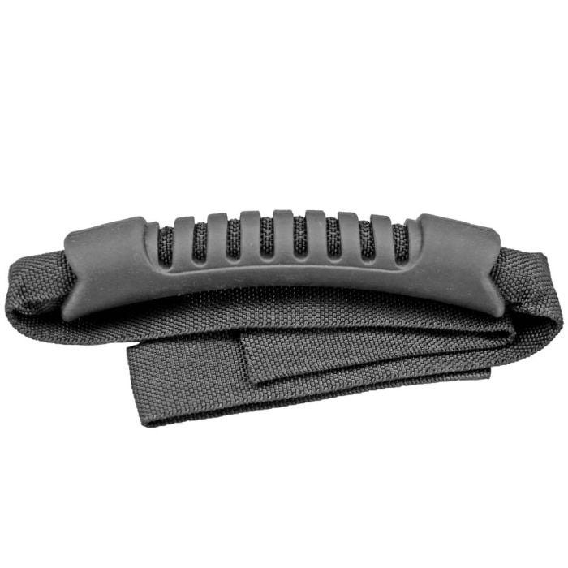
Ergonomics & disengaging
SPROUT UP
Strap adjuster
strap binding
Strap Coupler
Handle

Slide 4
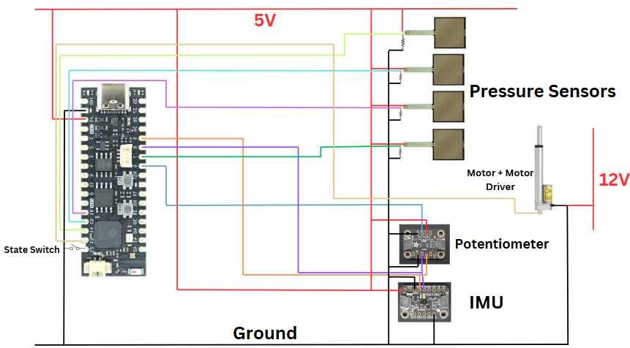
Electronics
SPROUT UP
Status: Electronics chosen and specced
Risk factors: Noise and connectivity
Remaining work: Order materials, test outputs, and integrate sensors to control scheme
= Force vector
= Knee angle
= Orientation & acceleration

Slide 5
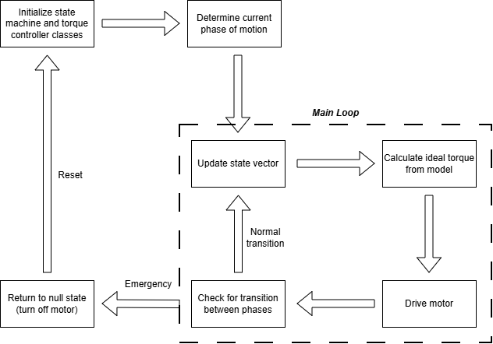
Logic and Modeling
SPROUT UP
Status: Kinematics and code structure is finished
Risk factors: model robustness + emergency override needed
Remaining work: implement dynamic model, assign phase transition thresholds, write low-level hardware/sensor code
Code block diagram
Notes:
PD Model
Adaptive code calculates and executes optimal torques based on inferred motion, with safeguards

Slide 6
Project Timeline
SPROUT UP
Weeks 1-5
Weeks 6-8
Weeks 9-10
Weeks 11-12
Weeks 13-14
Week 15
Team Formation & Ideation (DONE)
Detailed Design & Modeling
Part Selection & Fabrication Prep
Fabrication
Testing, Fine-Tuning, & Final Sprint
Final Presentation Preparation
Deliverables: Presentation 1, narrowed scope, initial design considerations
Deliverables: Detailed mech. design, robust dynamics & control model
Deliverables: Presentation 2, CAD models, BOM, and fabrication plan
Deliverables: Initial design, control, and sensing method ready for testing
Deliverables: Debug problems seen in testing, any other delayed objectives
Deliverables: Detailed final presentation, manufacturing plan, demonstration ready system

